Slide 1
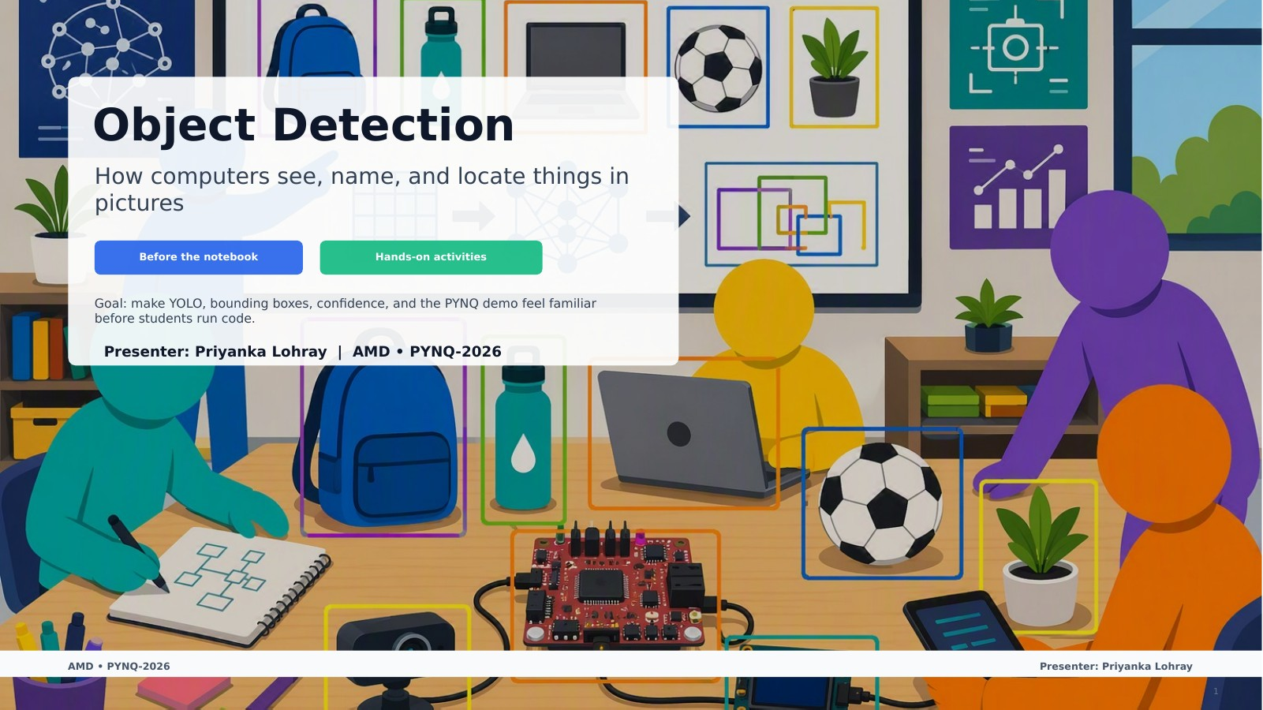
Object Detection
How computers see, name, and locate things in pictures
Before the notebook
Hands-on activities
Goal: make YOLO, bounding boxes, confidence, and the PYNQ demo feel familiar before students run code.
AMD • PYNQ-2026
Presenter: Priyanka Lohray
Notes:
Facilitator notes: Same visual format preserved from the existing deck. Slide content has been embedded as PowerPoint text in the slide for accessibility/search while the rendered slide image keeps the original look. [Sources] PYNQ 301 notebook source used in the original material: https://xilinx.github.io/PYNQ_Bootcamp/PYNQ301-object-detection.html

Slide 2
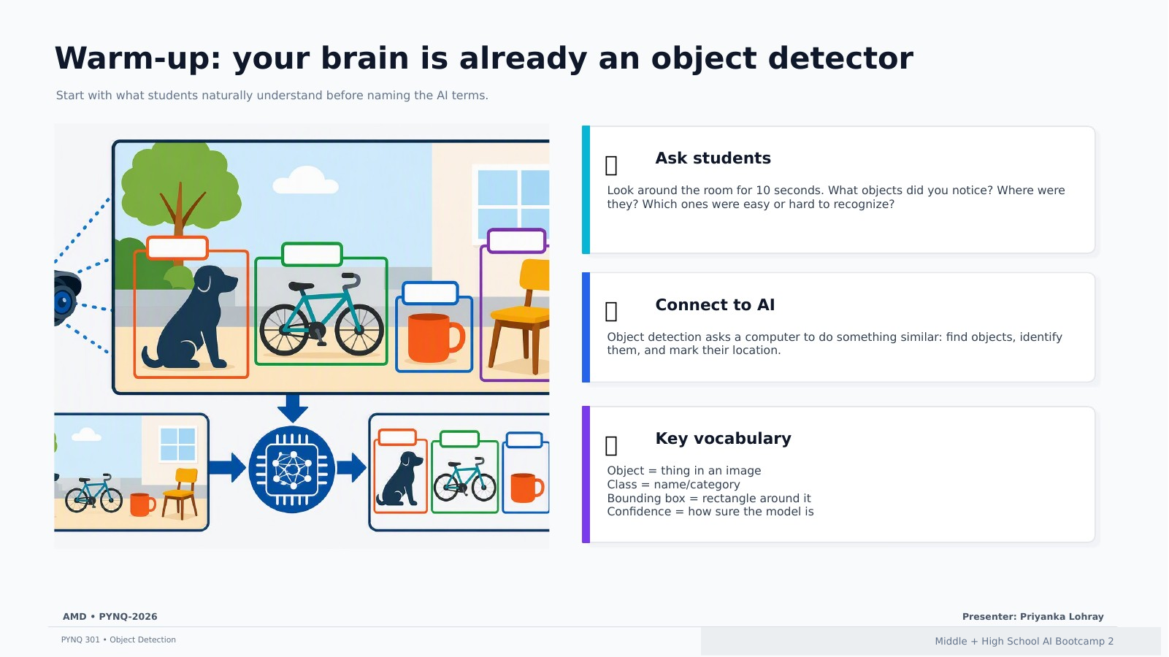
Warm-up: your brain is already an object detector
Start with what students naturally understand before naming the AI terms.
Ask students
Look around the room for 10 seconds. What objects did you notice? Where were they? Which ones were easy or hard to recognize?
Connect to AI
Object detection asks a computer to do something similar: find objects, identify them, and mark their location.
Key vocabulary
Object = thing in an image
Class = name/category
Bounding box = rectangle around it
Confidence = how sure the model is
AMD • PYNQ-2026
Presenter: Priyanka Lohray
Middle + High School AI Bootcamp 2
Notes:
Facilitator notes: Same visual format preserved from the existing deck. Slide content has been embedded as PowerPoint text in the slide for accessibility/search while the rendered slide image keeps the original look. [Sources] PYNQ 301 notebook source used in the original material: https://xilinx.github.io/PYNQ_Bootcamp/PYNQ301-object-detection.html

Slide 3
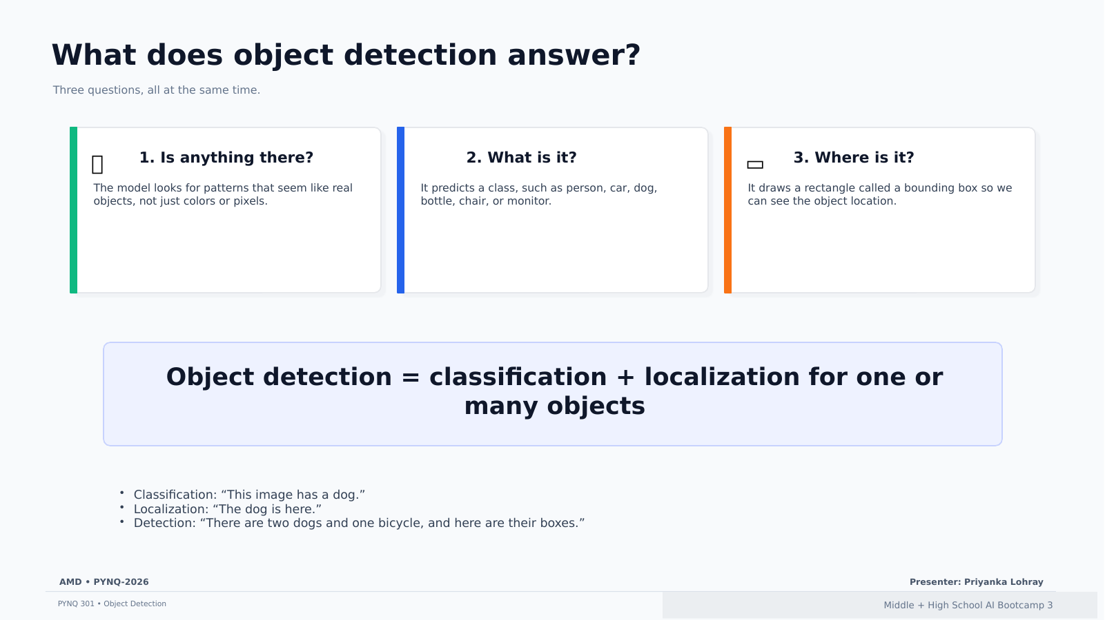
What does object detection answer?
Three questions, all at the same time.
1. Is anything there?
The model looks for patterns that seem like real objects, not just colors or pixels.
2. What is it?
It predicts a class, such as person, car, dog, bottle, chair, or monitor.
3. Where is it?
It draws a rectangle called a bounding box so we can see the object location.
Object detection = classification + localization for one or many objects
Classification: “This image has a dog.”
Localization: “The dog is here.”
Detection: “There are two dogs and one bicycle, and here are their boxes.”
AMD • PYNQ-2026
Presenter: Priyanka Lohray
Middle + High School AI Bootcamp 3
Notes:
Facilitator notes: Same visual format preserved from the existing deck. Slide content has been embedded as PowerPoint text in the slide for accessibility/search while the rendered slide image keeps the original look. [Sources] PYNQ 301 notebook source used in the original material: https://xilinx.github.io/PYNQ_Bootcamp/PYNQ301-object-detection.html

Slide 4
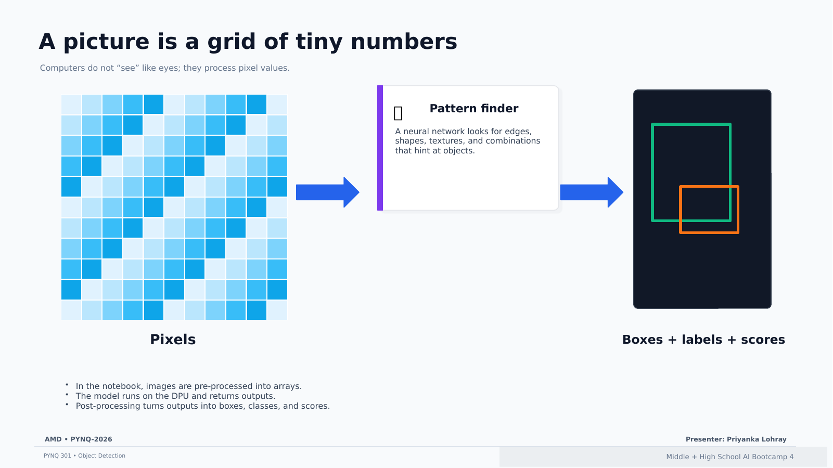
A picture is a grid of tiny numbers
Computers do not “see” like eyes; they process pixel values.
Pixels
Pattern finder
A neural network looks for edges, shapes, textures, and combinations that hint at objects.
Boxes + labels + scores
In the notebook, images are pre-processed into arrays.
The model runs on the DPU and returns outputs.
Post-processing turns outputs into boxes, classes, and scores.
AMD • PYNQ-2026
Presenter: Priyanka Lohray
Middle + High School AI Bootcamp 4
Notes:
Facilitator notes: Same visual format preserved from the existing deck. Slide content has been embedded as PowerPoint text in the slide for accessibility/search while the rendered slide image keeps the original look. [Sources] PYNQ 301 notebook source used in the original material: https://xilinx.github.io/PYNQ_Bootcamp/PYNQ301-object-detection.html

Slide 5
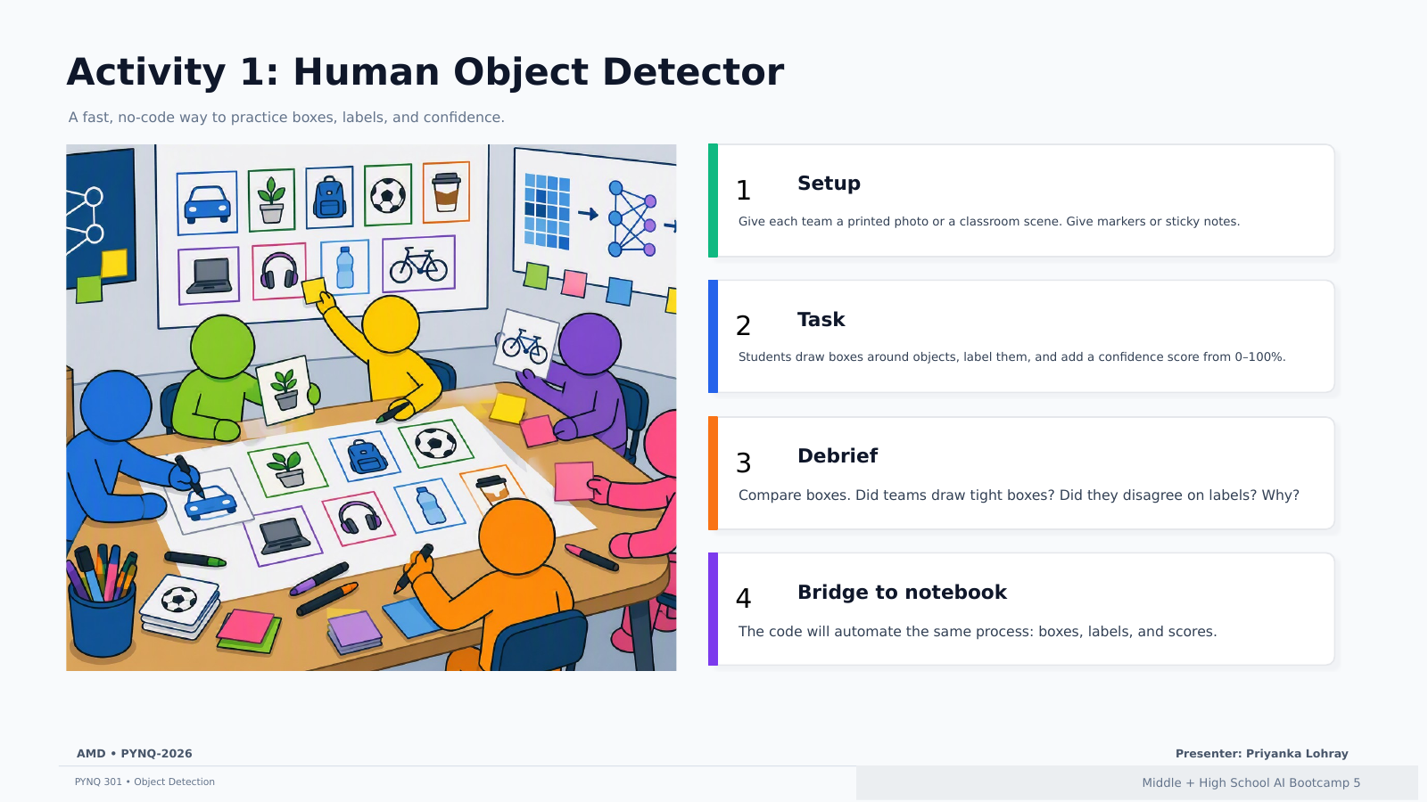
Activity 1: Human Object Detector
A fast, no-code way to practice boxes, labels, and confidence.
Setup
Give each team a printed photo or a classroom scene. Give markers or sticky notes.
Task
Students draw boxes around objects, label them, and add a confidence score from 0–100%.
Debrief
Compare boxes. Did teams draw tight boxes? Did they disagree on labels? Why?
Bridge to notebook
The code will automate the same process: boxes, labels, and scores.
AMD • PYNQ-2026
Presenter: Priyanka Lohray
Middle + High School AI Bootcamp 5
Notes:
Facilitator notes: Same visual format preserved from the existing deck. Slide content has been embedded as PowerPoint text in the slide for accessibility/search while the rendered slide image keeps the original look. [Sources] PYNQ 301 notebook source used in the original material: https://xilinx.github.io/PYNQ_Bootcamp/PYNQ301-object-detection.html

Slide 6
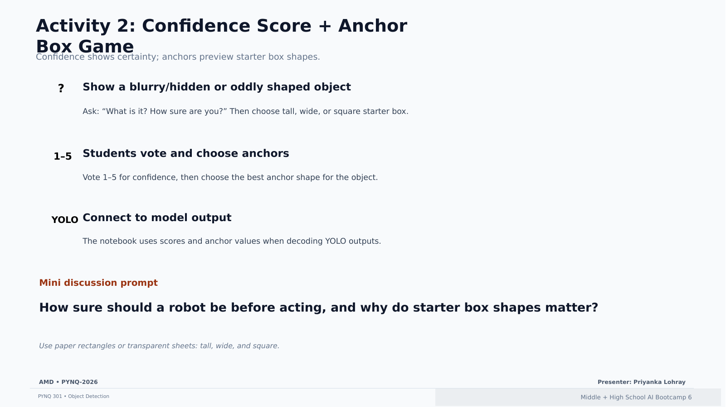
Activity 2: Confidence Score + Anchor Box Game
Confidence shows certainty; anchors preview starter box shapes.
Show a blurry/hidden or oddly shaped object
Ask: “What is it? How sure are you?” Then choose tall, wide, or square starter box.
Students vote and choose anchors
Vote 1–5 for confidence, then choose the best anchor shape for the object.
Connect to model output
The notebook uses scores and anchor values when decoding YOLO outputs.
Mini discussion prompt
How sure should a robot be before acting, and why do starter box shapes matter?
Use paper rectangles or transparent sheets: tall, wide, and square.
AMD • PYNQ-2026
Presenter: Priyanka Lohray
Middle + High School AI Bootcamp 6
Notes:
Facilitator notes: Same visual format preserved from the existing deck. Slide content has been embedded as PowerPoint text in the slide for accessibility/search while the rendered slide image keeps the original look. [Sources] PYNQ 301 notebook source used in the original material: https://xilinx.github.io/PYNQ_Bootcamp/PYNQ301-object-detection.html

Slide 7
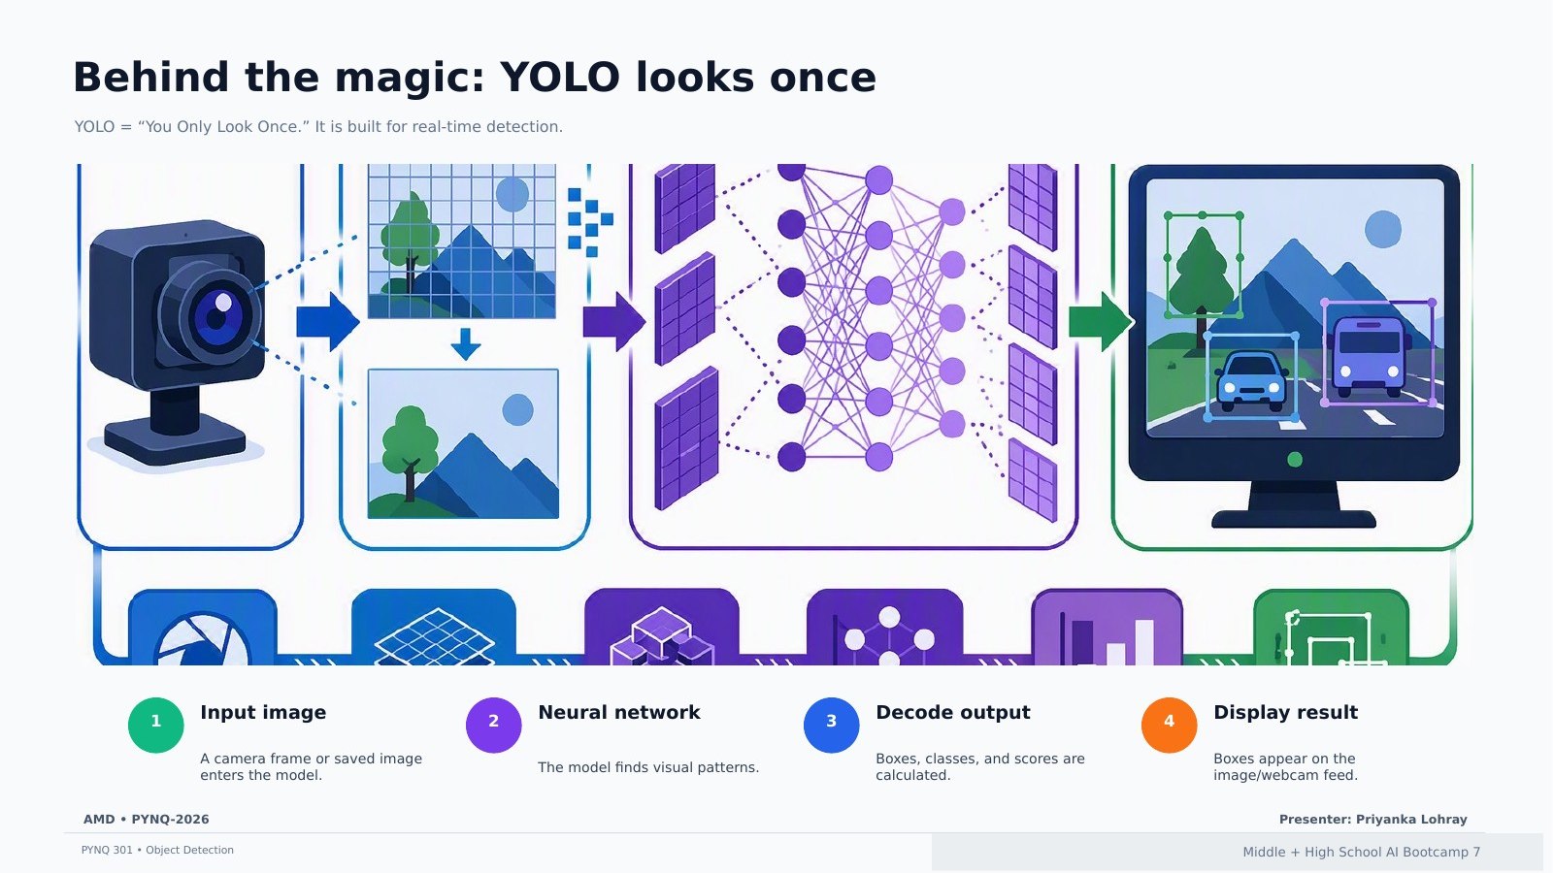
Behind the magic: YOLO looks once
YOLO = “You Only Look Once.” It is built for real-time detection.
1 Input image
A camera frame or saved image enters the model.
2 Neural network
The model finds visual patterns.
3 Decode output
Boxes, classes, and scores are calculated.
4 Display result
Boxes appear on the image/webcam feed.
AMD • PYNQ-2026
Presenter: Priyanka Lohray
Middle + High School AI Bootcamp 7
Notes:
Facilitator notes: Same visual format preserved from the existing deck. Slide content has been embedded as PowerPoint text in the slide for accessibility/search while the rendered slide image keeps the original look. [Sources] PYNQ 301 notebook source used in the original material: https://xilinx.github.io/PYNQ_Bootcamp/PYNQ301-object-detection.html

Slide 8
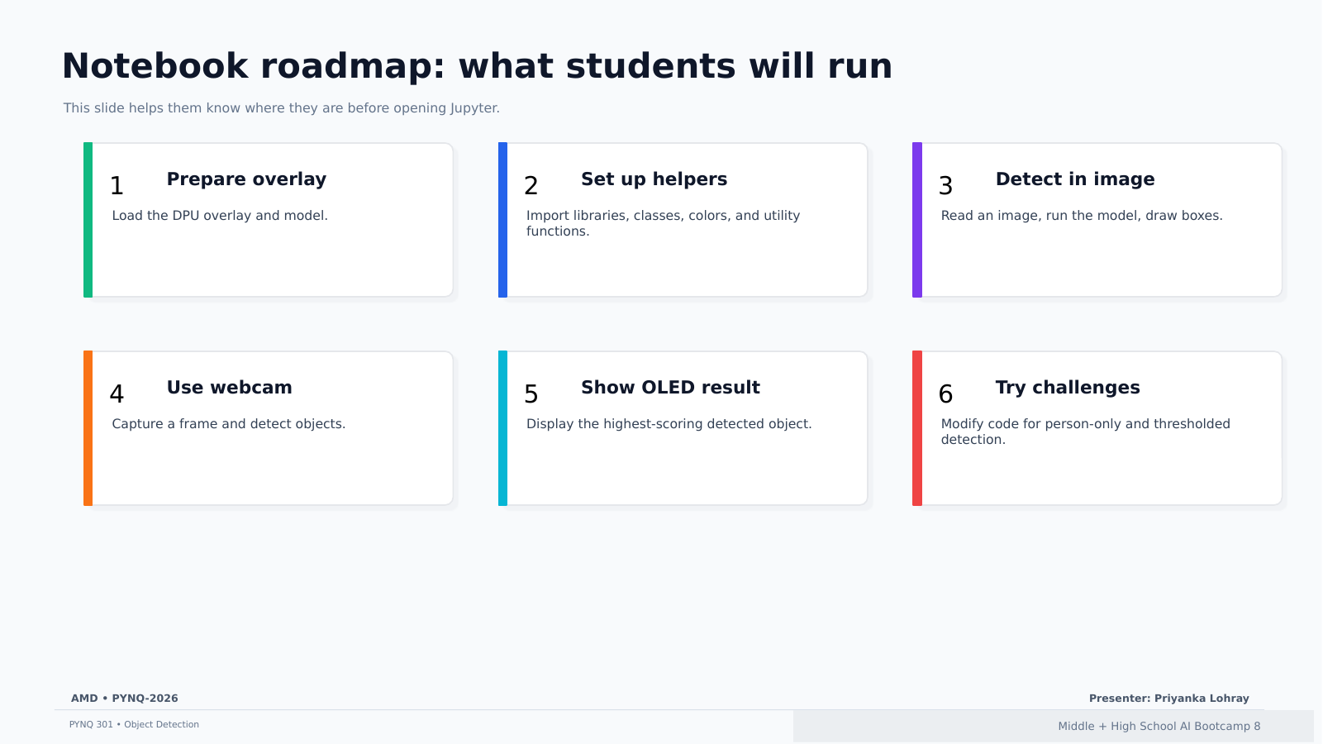
Notebook roadmap: what students will run
This slide helps them know where they are before opening Jupyter.
1 Prepare overlay
Load the DPU overlay and model.
2 Set up helpers
Import libraries, classes, colors, and utility functions.
3 Detect in image
Read an image, run the model, draw boxes.
4 Use webcam
Capture a frame and detect objects.
5 Show OLED result
Display the highest-scoring detected object.
AMD • PYNQ-2026
Presenter: Priyanka Lohray
Middle + High School AI Bootcamp 8
Notes:
Facilitator notes: Same visual format preserved from the existing deck. Slide content has been embedded as PowerPoint text in the slide for accessibility/search while the rendered slide image keeps the original look. [Sources] PYNQ 301 notebook source used in the original material: https://xilinx.github.io/PYNQ_Bootcamp/PYNQ301-object-detection.html

Slide 9
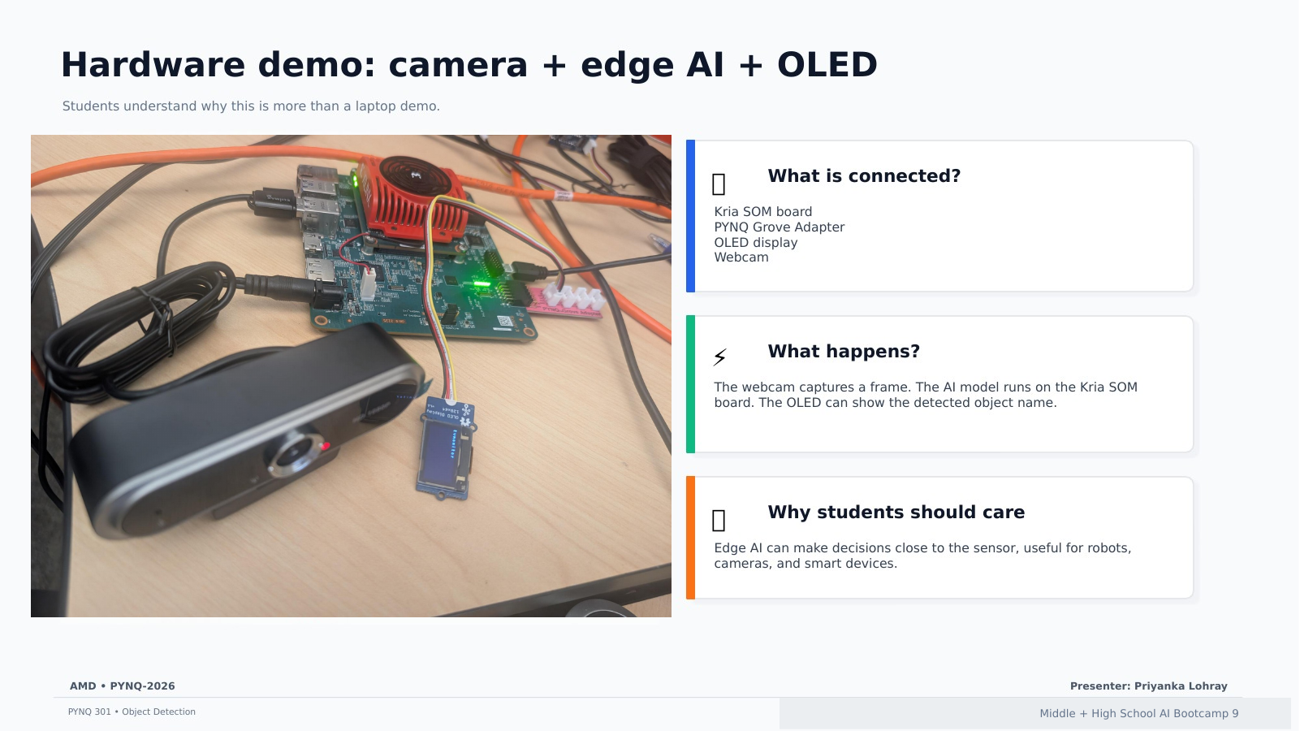
Hardware demo: camera + edge AI + OLED
Students understand why this is more than a laptop demo.
What is connected?
Kria SOM board
PYNQ Grove Adapter
OLED display
Webcam
What happens?
The webcam captures a frame. The AI model runs on the Kria SOM board. The OLED can show the detected object name.
Why students should care
Edge AI can make decisions close to the sensor, useful for robots, cameras, and smart devices.
AMD • PYNQ-2026
Presenter: Priyanka Lohray
Middle + High School AI Bootcamp 9
Notes:
Facilitator notes: Same visual format preserved from the existing deck. Slide content has been embedded as PowerPoint text in the slide for accessibility/search while the rendered slide image keeps the original look. [Sources] PYNQ 301 notebook source used in the original material: https://xilinx.github.io/PYNQ_Bootcamp/PYNQ301-object-detection.html

Slide 10
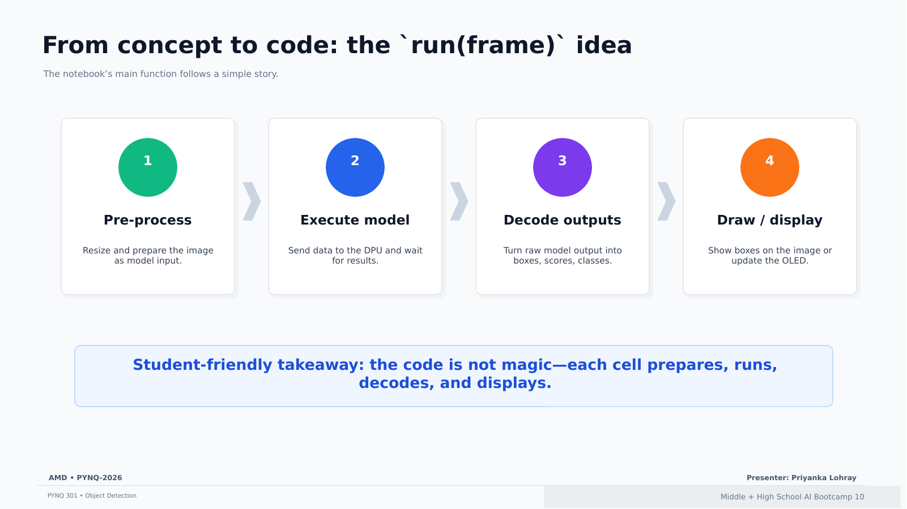
From concept to code: the run(frame) idea
The notebook’s main function follows a simple story.
1 Pre-process
Resize and prepare the image as model input.
2 Execute model
Send data to the DPU and wait for results.
3 Decode outputs
Turn raw model output into boxes, scores, classes.
4 Draw / display
Show boxes on the image or update the OLED.
Student-friendly takeaway: the code is not magic—each cell prepares, runs, decodes, and displays.
AMD • PYNQ-2026
Presenter: Priyanka Lohray
Middle + High School AI Bootcamp 10
Notes:
Facilitator notes: Same visual format preserved from the existing deck. Slide content has been embedded as PowerPoint text in the slide for accessibility/search while the rendered slide image keeps the original look. [Sources] PYNQ 301 notebook source used in the original material: https://xilinx.github.io/PYNQ_Bootcamp/PYNQ301-object-detection.html

Slide 11
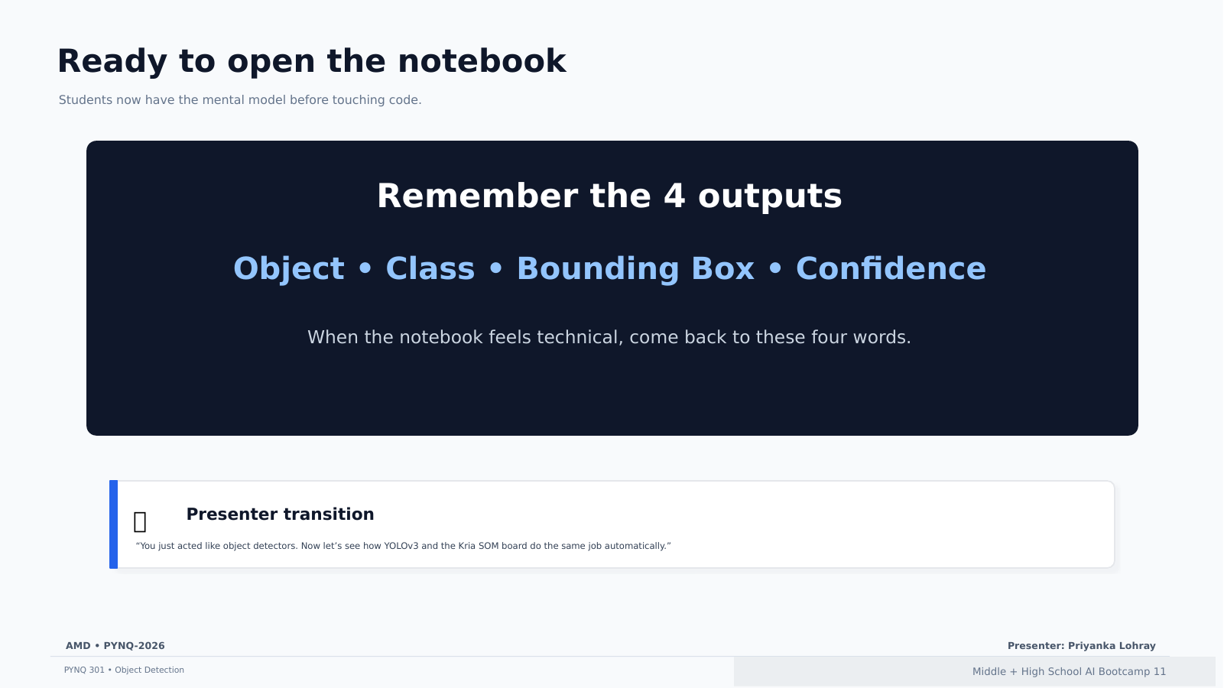
Ready to open the notebook
Students now have the mental model before touching code.
Remember the 4 outputs
Object • Class • Bounding Box • Confidence
When the notebook feels technical, come back to these four words.
Presenter transition
“You just acted like object detectors. Now let’s see how YOLOv3 and the Kria SOM board do the same job automatically.”
AMD • PYNQ-2026
Presenter: Priyanka Lohray
Middle + High School AI Bootcamp 11
Notes:
Facilitator notes: Same visual format preserved from the existing deck. Slide content has been embedded as PowerPoint text in the slide for accessibility/search while the rendered slide image keeps the original look. [Sources] PYNQ 301 notebook source used in the original material: https://xilinx.github.io/PYNQ_Bootcamp/PYNQ301-object-detection.html

